Slide 1
The R+-Tree: A Dynamic Index for Multi-Dimensional Objects
Timos Sellis (University of Maryland - College Park)
Nick Roussopoulos (University of Maryland - College Park)
Christos Faloutsos (Carnegie Mellon University)
Presenter: Xunfei Jiang

Slide 2
Introduction
Data Categories
One-dimensional data
Integer
Real numbers
Strings
Multi-dimensional data
Boxes
Polygons
Points in multi-dimensional space

Slide 3
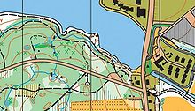
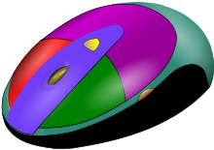

Multi-dimensional data in application areas
Cartography
CAD(Computer-Aided Design)
Computer Vision and robotics
Rule indexing in expert database systems

Slide 4
DBMS with multi-dimensional data
Addressed operations
Point queries
Given a point in the space, find all objects that contain it
Region queries
Given a region (query window), find all objects that intersect it
Un- addressed operations
Insertion
Deletion
modification
Need support in dynamic environment

Slide 5
Survey
Classification of multi-dimensional objects
Points
Rectangles
Circles, polygons and other complex objects can be reduced to rectangles(MBRs)

Slide 6
Points
Method
divide the whole space into disjoint sub-regions
each sub-region contains no more than C points
usually C = 1 /the capacity of a disk page(number of data records the page can hold)
Operations
Insertion
Split: further partition of a region
introduce a hyper-plane and divided region into disjoint sub-regions

Slide 7
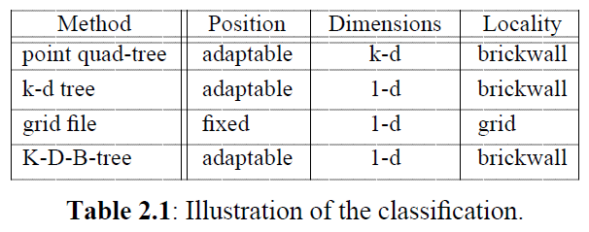
Attribute of Split
Position of Hyper-plane
Fixed
Hyper-plane is predetermined
Adaptable
Let the data point determine the position of the hyper-plane
Dimensionality
One hyper-plane
K hyper-plane
Locality
Grid method: split all regions in this direction
Brickwall method: split only the region that need to be spitted

Slide 8
Rectangles
Methods classification
(1) transform the rectangles into points in a space of higher dimensionality
Eg: 2-d rectangle be considered as 4-d point
(2) use space filling curves to map a k-d space onto a 1-d space
Eg: transform k-dimensional objects to line segments, using the so-called z-transform.
preserve the distance
points that are close in the k-d space are likely to be close in the 1-d transformed space

Slide 9
(3) divide the original space into appropriate sub-regions
Disjoint regions: any of the methods for points could be used for rectangles
rectangle intersect a splitting hyper-plane
Solution: cut the offending rectangle in two pieces and tag the pieces, to indicate that they belong to the same rectangle.
Splitting hyper-planes can be of arbitrary orientation(not necessarily parallel to the axes).
Overlapping regions:
Guttman proposed R-Trees
extension of B-trees for multi-dimensional objects that are either points or regions.
Guarantee that the space utilization is at least 50%.
if R-Trees are built using the dynamic insertion algorithms, the structure may provide excessive space overlap and "dead-space" in the nodes that result in bad performance. (R+-tree address this problem)

Slide 10
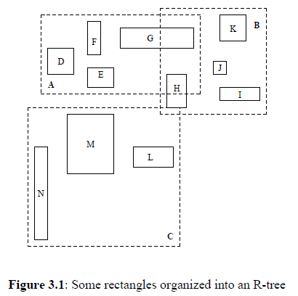
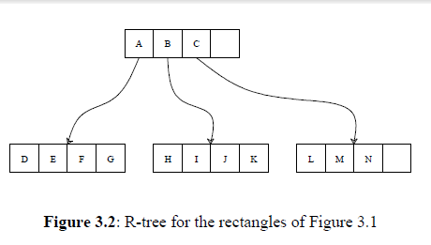
R Tree
R-tree
Extension of B-tree in k-dimensions
Height-balanced tree
Components
Intermediate nodes: grouping rectangles
leaf nodes: data objects
Each intermediate node encloses all rectangles that are correspond to lower level nodes

Slide 11
R-tree
Coverage
The total area of all the rectangles associated with the nodes of that level.
Overlap
the total area contained within two or more nodes.

Slide 12
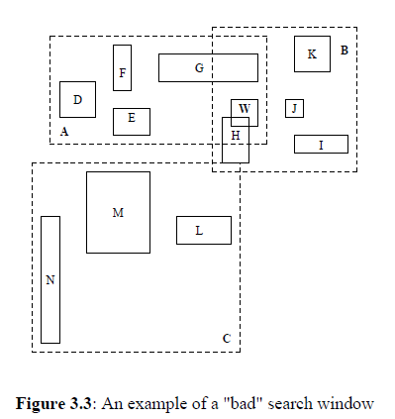
Efficient R-tree
Minimize coverage
reduce dead space(i.e. empty space)
Minimize overlap
E.g: search window w result in search both nodes A and B
Zero overlap & coverage?
Achievable for data points that are known in advance
Zero overlap is not attainable for region objects
partition
R+ Tree
Zero overlap

Slide 13
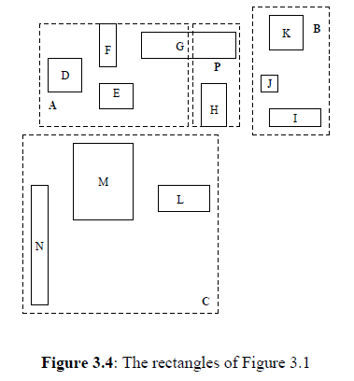
R+ tree
Whenever a data rectangle at a lower level overlaps with another rectangle, decompose it into two non-overlapping sub-rectangles
Eg: Rectangle G is split into two sub-rectangles: one contained in node A; the other contained in node P.
Pros and cons:
time saving on searching
increase space cost

Slide 14
R+ tree
Structure
Leaf node
Intermediate node
( oid, RECT)
( p, RECT)
Data object
Bounds of data objects
Pointer to a lower level node
Rectangle that encloses the nodes in lower level

Slide 15
R+ tree
Properties
(1) For each entry (p, RECT ) in an intermediate node, the sub-tree rooted at the node pointed to by p contains a rectangle R if and only if R is covered by RECT.
Exception: R is a rectangle at a leaf node -> R must just overlap with RECT.
(2) For any two entries (p1,RECT1) and (p2,RECT2) of an intermediate node, the overlap between RECT1 and RECT2 is zero.
(3) The root has at least two children unless it is a leaf.
(4) All leaves are at the same level.

Slide 16
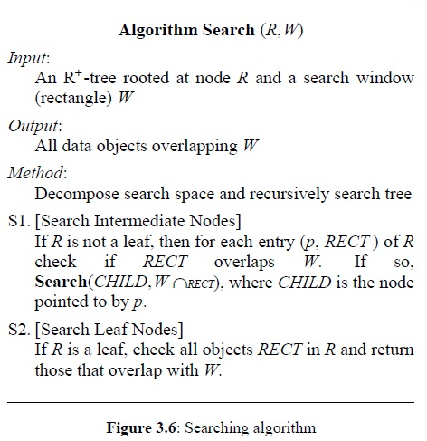
Search
Search(R,W)
Search(P,W)
Search(H,W)
H

Slide 17
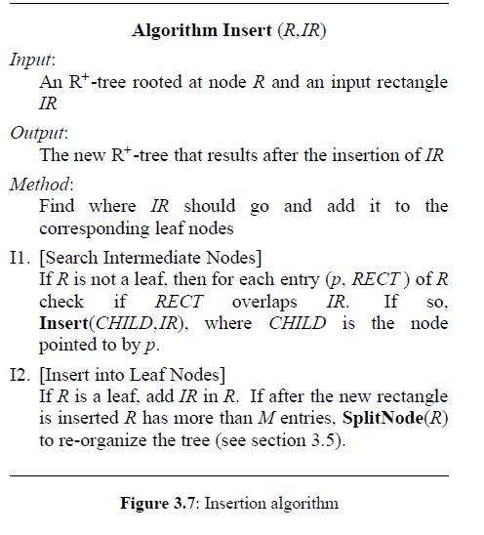
Insert
IR
IR
A
B
C
P
SplitNode
D
E
F
G1
K
I
J
M
N
L
H
G2

Slide 18
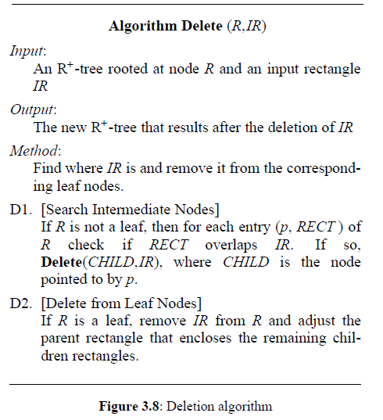
Deletion
A
B
C
P
D
E
F
G1
K
I
J
M
N
L
H
G2
Delete G1
Delete G2
A
A
B
B
C
C
P
P
D
D
E
E
F
F
K
K
I
I
J
J
M
M
N
N
L
L
H
H
G2
NEED ADJUST

Slide 19
Node Splitting
Input: A node R (leaf or intermediate)
Output: The new R+-tree
Method: [SN1]Find a partition for the node to be split, [SN2]create two new nodes and, if needed, [SN3]propagate the split upward and downward
SN1. [Find a Partition]
Partition R using the Partition routine of the Pack algorithm (see next section).
Partition node R (p, RECT), let S1 and S2 denote the two sub-regions resulting after the partition. Create two nodes:
n1=(p1,RECT1)
n2=(p2,RECT2)
RECTi=RECT ∩ Si (i=1,2)
p, RECT
p1, RECT1
p2, RECT2
n1
n2

Slide 20
Node Splitting
SN2. [Populate New Nodes]
Put all the sub-nodes of R into ni ( i = 1,2 )
For those nodes(pk, RECTk) that overlap with the sub-regions
a) R is a leaf node, put RECTk in both new nodes
b) Otherwise, use SplitNode to recursively split the children nodes along the partition.
Let (pk1,RECTk1) and (pk2,RECTk2) be the two nodes after splitting (pk,RECTk), where RECTki lies completely in RECTi , i=1,2.
Add those two nodes to the corresponding node ni .
RECTk1
RECTk2
(a)
(b)
n1
M
R
n1
n2
d
e
a
c
n2
R
T
a
f
i
N
d
b
h
b
c
g

Slide 21
Node Splitting
SN3. [Propagate Node Split Upward]
If R is the root, create a new root with only two children, n1 and n2.
Otherwise, let PR be R’s parent node. Replace R in PR with n1 and n2. If PR has now more than M entries, invoke SplitNode(PR).

Slide 22
Packing Algorithm
Partition
divides the total space occupied by N 2-dimensional rectangles by a line parallel to the x-axis(x_cut) or the y-axis (y_cut).
The selection of the x_cut or y_cut is based on one or more of the following criterias:
(1) nearest neighbors
(2) minimal total x − and y-displacement
(3) minimal total space coverage accrued by the two sub-regions
(4) minimal number of rectangle splits.
(1)(2)(3) reduce search by reducing the
coverage of "dead-space".
(4) confines the height expansion of the R+-tree

Slide 23
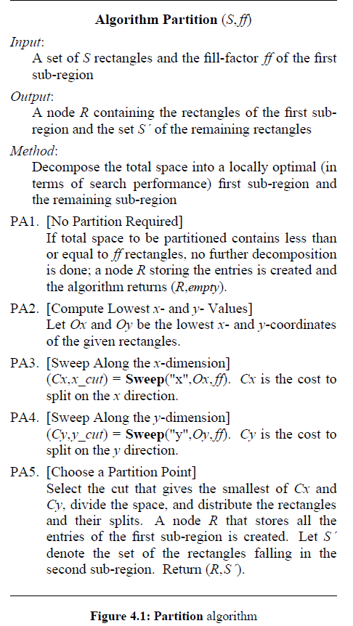
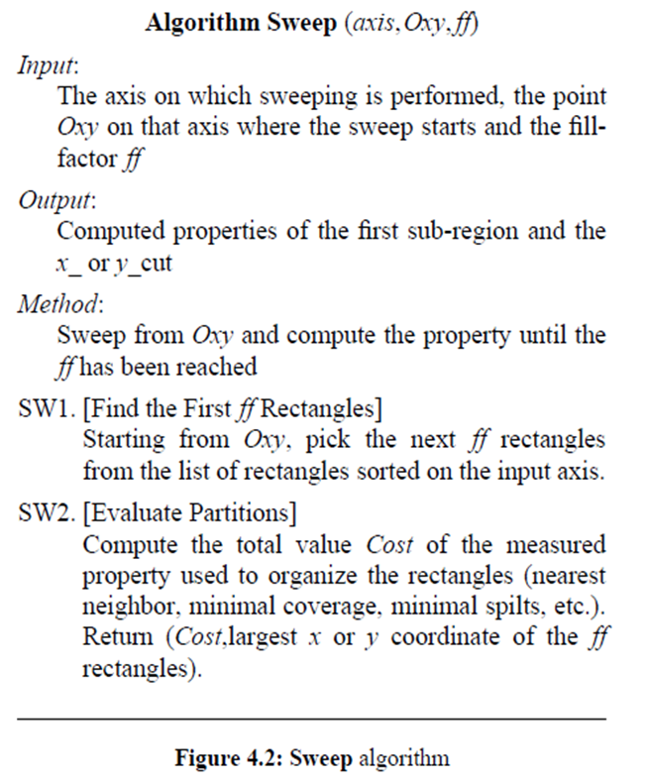
Partition
ff: the capacity of a node or some predefined fraction of it according to some desired loading factor.
Sweep: sweeps the space in a fashion parallel to the x- or y- axis.
y
e
a
S’
R
b
d
c
Oy
Ox
x
ff=3

Slide 24
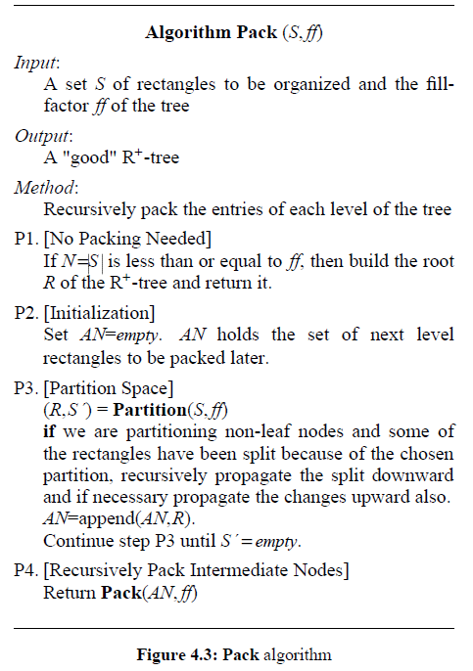
Pack
a
c
b
d
ff = 4
R
a
b
c
d
ff = 2
R
R’
S’
b
d
a
a
c
c
AN = {R}
AN = {R,R’}

Slide 25
Analysis
Rectangle
4 coordinates are enough to uniquely determine it (the x and y coordinates of the lower-left and upper-right corners).
examine segments on a line (1-d space) instead of rectangles in the plane (2-d space), and transform the segments into points in a 2-d space.
Each segment is uniquely determined by (xstart , xend), the coordinates of its start and end points.
Density(D)
the number of segments that contain a given point

Slide 26
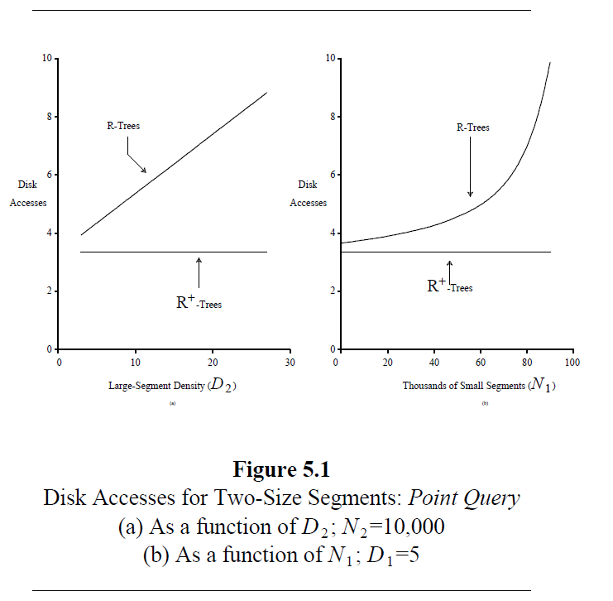
search performance in query of points
100,000 segments
total density: 40
Figure 5.1a
disk accesses=f(large segment density)
large segments account for 10% of the total number of segments
N1=90,000
N2=10,000
Figure 5.1b
disk accesses= f(small segments)
small segment density (D1=5).

Slide 27
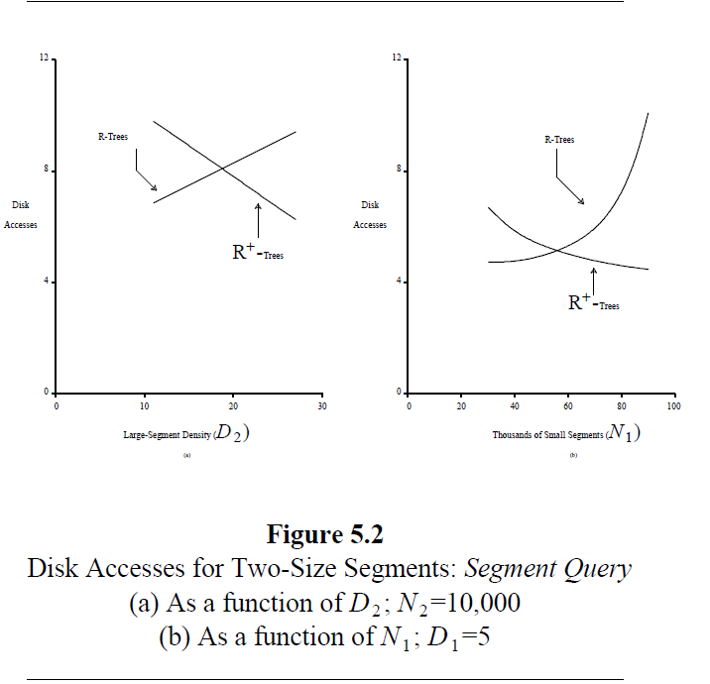
search performance in query of SEGEMENTs
N1 increase, few lengthy segments :
R+-trees gain a performance improvements of up to 50%.
N2 approaches the total number of segments, R+-trees will lose
many lengthy segments cause a lot of splits to sub-segments.

Slide 28
conclusion
Advantage of R+-trees compared to R-trees
improve search performance
especially in point queries, more than 50% savings in disk accesses.
R-trees suffer in the case of few, large data objects
force a lot of "forking" during the search.
R+-trees handle these cases easily
they split these large data objects into smaller ones.
behaves exactly as a K-DB-tree(efficient for indexing point data) in the case where the data is points instead of non-zero area objects (rectangles).

Slide 29
Future work
Experimentation through simulation to verify the analytical results.
Extension of the analysis for rectangles on a plane (2-d), and eventually for spaces of arbitrary dimensionality.
Design and experimentation with alternative methods for partitioning a node and compacting an R+-tree.
Comparison of R- and R+-trees with other methods for handling multi-dimensional objects.

Slide 30

Thanks!

